Slide 1
JavaScript
An Overview

Slide 2
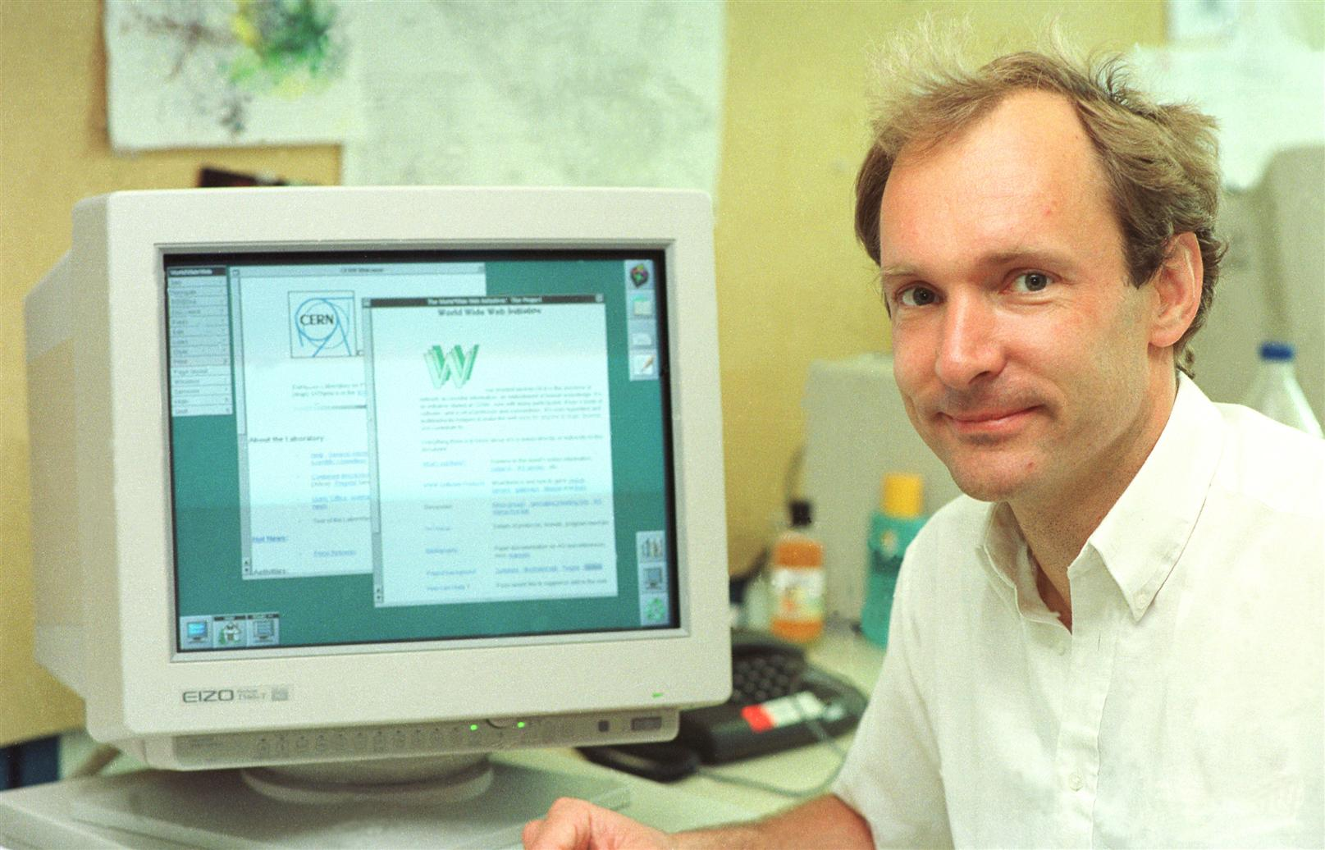
The Web Revolution
Tim Berners-Lee, a British scientist, invented the World Wide Web (WWW) in 1989, while working at CERN.
The Web was originally conceived and developed to meet the demand for automated information-sharing between scientists in universities and institutes around the world.
First web page: http://info.cern.ch/hypertext/WWW/TheProject.html
Source: https://home.cern/science/computing/birth-web/short-history-web

Slide 3

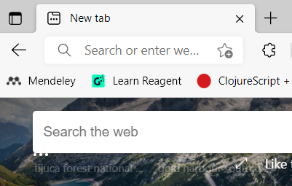
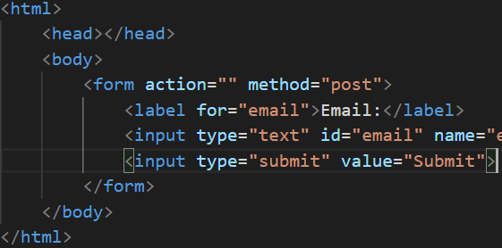

Browser
XXX
80/443
listening
Server
Parsing & Rendering
Operating System
(xwindow, keyboard driver)
Operating System
index.html
Client Machine
Server Machine
Notes:
Use netstat -a -b to find the port or resource monitor from ctrl+alt+delete

Slide 4
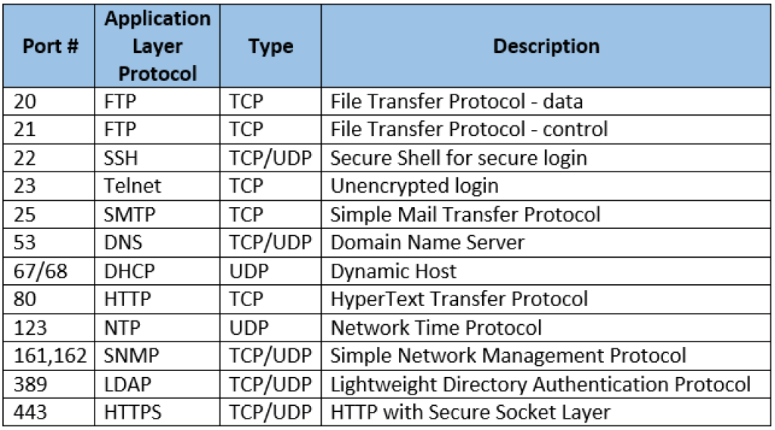

Slide 5


What is a server?
What is a HTTP server?
HTML
Can your Laptop be a (HTTP) server?
HTTP
How?

Slide 6
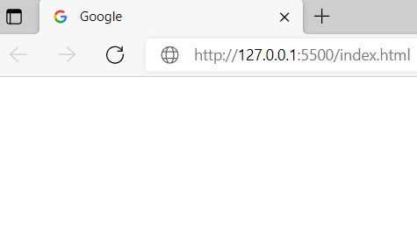
Browser
XXX
80
listening
Server
Parsing & Rendering
Operating System
(xwindow, keyboard driver)
Operating System
index.html
index.html
Client Machine
Server Machine
Notes:
Use netstat -a -b to find the port

Slide 7
Browser
XXX
80
listening
Server
HTTP Request
Parsing & Rendering
Operating System
(xwindow, keyboard driver)
Operating System
index.html
index.html
Client Machine
Server Machine
Notes:
Use netstat -a -b to find the port

Slide 8
Browser
XXX
80
listening
Server
HTTP Request
Parsing & Rendering
Finds in filesystem
Operating System
(xwindow, keyboard driver)
Operating System
index.html
index.html
Client Machine
Server Machine
Notes:
Use netstat -a -b to find the port

Slide 9
Browser
XXX
80
listening
Server
HTTP Request
Packages as HTTPresponse
Parsing & Rendering
Operating System
(xwindow, keyboard driver)
Operating System
index.html
index.html
Client Machine
Server Machine
Notes:
Use netstat -a -b to find the port

Slide 10
Browser
XXX
80
listening
Server
HTTP Response
Parsing & Rendering
Operating System
(xwindow, keyboard driver)
Operating System
index.html
index.html
Client Machine
Server Machine
Notes:
Use netstat -a -b to find the port

Slide 11
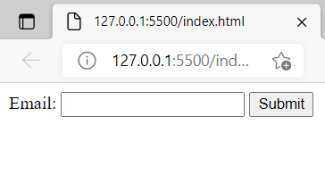
Browser
XXX
80
listening
Server
HTTP Response
Parsing & Rendering
Parses and Renders
Operating System
(xwindow, keyboard driver)
Operating System
index.html
index.html
Client Machine
Server Machine
Notes:
Use netstat -a -b to find the port

Slide 12
Now let's ask ourselves the following question
What happens when an user types in ‘ax123’ and submits it?
The server (hopefully!) sends back an error
Is that a productive use of bandwidth (and very limited) server resources?
No
Assume we have a more complicated form
Requirement: someone who checks ‘yes’ for disability fills in a textbox, explaining the type of disability.
Is there a way to ensure that the textbox is enabled on when someone selects ‘yes’.

Slide 13
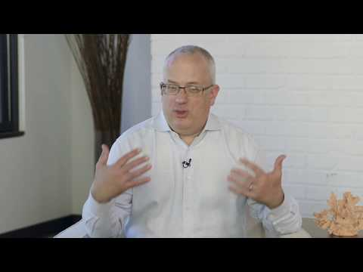

Slide 14
Browser
XXX
80
listening
Server
Parsing & Rendering
JavScript Engine
Operating System
(xwindow, keyboard driver)
index.html
Client Machine
Server Machine
Notes:
Use netstat -a -b to find the port

Slide 15
Lets see a quick demo
VSCode Live server
HTML + JS for email validation
Directly on the browser
Just Debugging
Replit.com
Same HTML + JS for email validation

Slide 16
“Hosted” language
Never intended to work alone
Always runs with “friends”
Hosted in an environment
Like in a browser
In a C++ shell - Node - explained later
Relies on “friends” in the hosting environment for some of the features

Slide 17
Popular JavaScript Engines
Chrome has V8 Engine
So does Node.js
Firefox has Spidermonkey
Safari has JavaScriptCore (also called Nitro)
Edge has Chakra

Slide 18
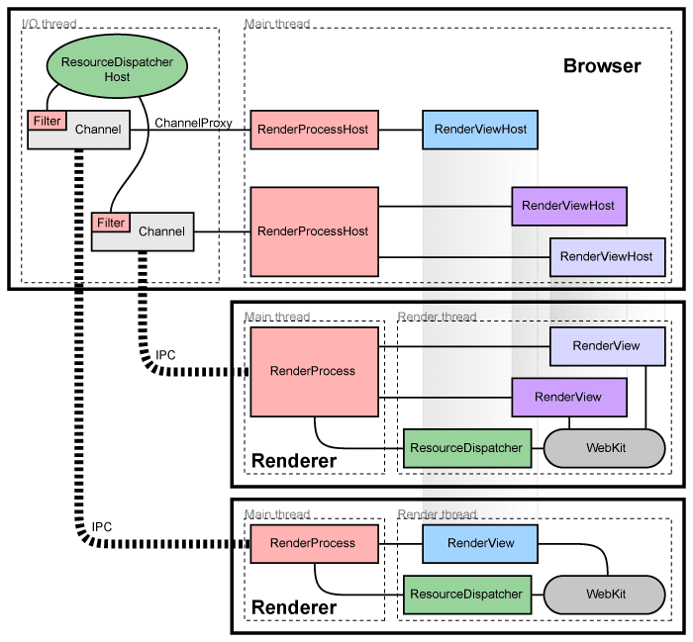
Inside WebKit there is JavaScriptCore - JavaScript Engine V8
Chrome Multi Process Architecture

Slide 19
Caution: The following slides show a heavily (unapologetically) simplified model of javascript in Browser, so as to help you understand. Use this just as a tool/mental model to understand javascript-in-browser vs javascript-in-Nodejs. DO NOT interpret the modules literally! For example, there is no such thing called ‘friend’

Slide 20
Javascript is single threaded!
But its not slow
But how does it get work done
It works similar to IIITS students
When you can’t do the assignment what do you do?
Ask your friend to do it and go to sleep/watch movie
Tell him to wake you up when he is done
The friends are threads (workers) spawned and run by the hosted environment

Slide 21
Browser
(program
written in C++)
WEB
APIS
Renderer (HTML) friend
V8 JavScript Engine
Network (xpc) friend
Webpage
Timer friend
URL
Other HTML related friend
JavaScript is executed as needed - triggered by events
Some other useful friend

Slide 22
How shall we design this??
Outcome of Code execution
JavaScript
Code

Slide 23
A program
written in C/C++
Idea: Let’s start by Copying the entire browser program and may be remove things that are not needed!
WEB
APIS
Renderer (HTML) friend
V8 JavScript Engine
Network (xpc) friend
Outcome of Code execution
JavaScript
Code
Timer friend
Other HTML related friend
Some other useful friend

Slide 24
A program
written in C/C++
This is what Ryan Dhal did for Node
APIS
We kept the Network friend around because we still want to talk to the internet
NODE
V8 JavScript Engine
Network (xpc) friend
Outcome of Code execution
JavaScript
Code
Timer friend
caution: The sheer amount of thing removed was plenty. Not just 2 components
Some other useful friend

Slide 25
Lets see a quick demo
Same simple email validation in Node
VSCode
Replit

Slide 26
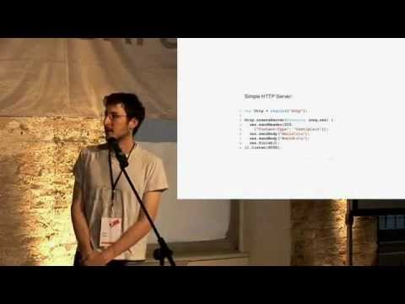

Slide 27
Node - Run JavaScript locally
It can talk to the local file system through OS
It can listen to a port for requests
Hence you can use it to create Servers
Voilà now you can write javascript for server side operations
Unlike the browser you can even increase the number of worker threads in the worker pools
Node (libuv) starts with 4 workers in the pool
You can also implement your own pools

Slide 28
Summary
Created by Brendan Eich for Netscape browser (1995ish)
In 10 days
Started as ‘Scheme in a browser’
Hosted language
Needs friends
Browser brings in all the friends
Ryan Dhal said
Don’t worry JS! No need for a browser!
I’ll give you all the friends you need! Let’s C
Node (2009)

Slide 29
Note on Project

Slide 30
Recap on project for FSD1! (FFSD)
Multi Page
Dynamic
Web Application
With DB integration
For persistence
Stack
HTML, CSS and/or CSS Frameworks
Node + Express (useful middlewares)
DBMS (SQL or NoSQL)

Slide 31
Note on project for FSD1! (FFSD)
Single Page
Dynamic
Web Application
With Mock Endpoint integration
Stack
HTML, CSS and/or CSS Frameworks
React, Redux and Node
JSONserver (or similar for mock end point)

Slide 32
MULTI PAGE APPLICATION
User
Screen/KeyBoard
Type URL
Browser Software
Server
HTTP request
HTTP Response
PAGE 1
Render Page 1
Click link/ Submit Form
HTTP request
HTTP Response
PAGE 2
Render Page 2

Slide 33
Generic Types of Web Applications
E-Commerce application
Nykaa, floweraura, etc
E-Commerce MarketPlace
Ebay, Amazon, etc
Social Network Applications (& Layers)
Facebook, Linkedin, etc
Other

Slide 34
E-Commerce application (Type-1)
Goods :- flowers, tires, cars
Services:- AC repair, Car wash
Hybrid :- Food orders (time dependent good/service)
Content:- News, Courses, Legal documents, Training services
Payment could be on-spot, on-delivery or recurring (subscription)

Slide 35
E-Commerce Marketplace application (Type-2)
Similar to E-commerce
But provides a platform for two types of users
Buyers
Sellers
Sellers could be
Corporate
individual (example: book lending site)

Slide 36
Social Networking Application (Type-3)
Connects people
Requires a theme
Professional (linkedin)
Personal (facebook, tinder)
Provide auxiliary services
Example: linkedin-job search

Slide 37
Other (Type-4)
Free-Commerce
Similar to E-commerce content sites, but provide it for free
Make money through other means
Ad revenue
Sponsors
Collecting and selling User behavior data
Example: RottenTomatoes, YouTube, etc
Aggregators
News360 (news aggregator), edealinfo (deals aggregator)
Search engines (google, duckduckgo, etc)
Wikis
OTT platforms
Many Many more…..

Slide 38
SINGLE PAGE APPLICATION
User
Screen/KeyBoard
Type URL
Browser Software
Server
HTTP request
PAGE
HTTP Response
Render Page
Do any actions
Javascript Engine
Async HTTP request
REST!
Modify portions of the page
HTTP Response

Slide 39
JavaScript
The Language - Basics

Slide 40
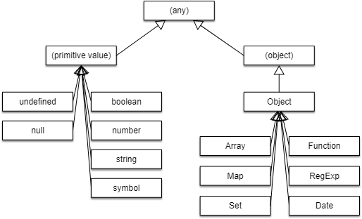
JAVASCRIPT TYPE HIERARCHY

Slide 41
Our Checklist
Let & Const
Tour of types
Primitives
Boolean
String
Number
Reference types
Object
Arrays
Functions

Slide 42
JavaScript
Event Loop, Task Queue & Call Stack

Slide 43
Buzz words!
Single threaded
Non-blocking
Asynchronous
Concurrent
Event-driven
Dynamic
Loosely-typed

Slide 44
Javascript & Friends
We already saw JS doesn’t work alone and only works with friends (provided by the Hosted environment browser/node)
But how ?
How does it communicate with the friends?
Web APIs true! But what else
How do they communicate back?
What’s under the hood?

Slide 45
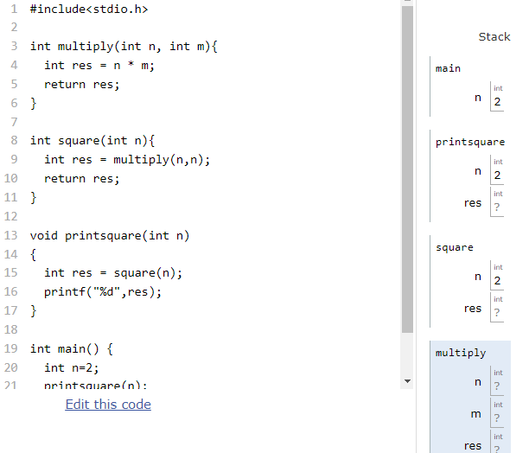
Let’s start with a recap of Call Stack (for C)

Slide 46
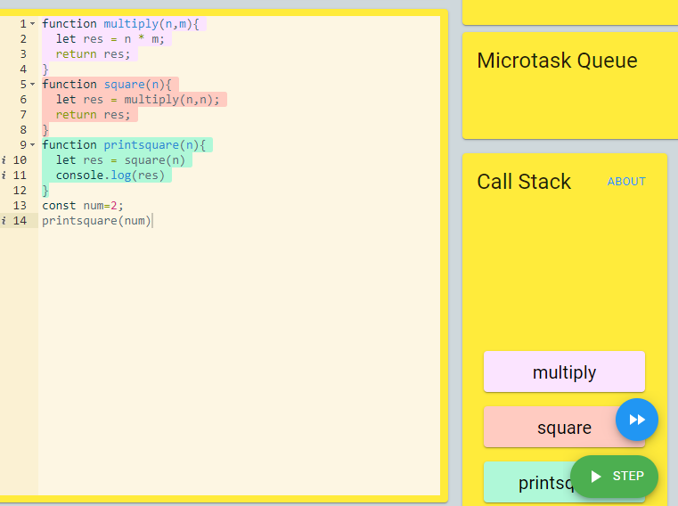
Let’s start with a recap of Call Stack
(Not so different for Javascript)

Slide 47
What does single threaded means?
At any given time there can be ONLY ONE STACK
For multithreaded languages, each thread gets its very own stack
‘Main’ is the first thread
Javascript uses the ‘event loop’ and the ‘task queue(s)’ to achieve the communication with the friends
Lets see a simple example

Slide 48
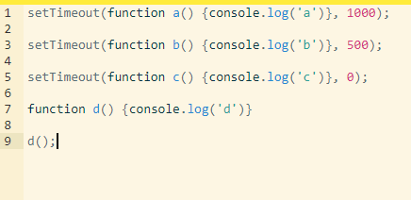
Lets see a simple example

Slide 49
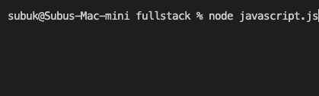

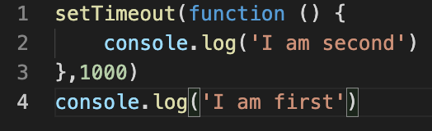
Call Stack
Console
Timer friend
(Node timer thread)
Event Loop
Task Queue

Slide 50
Call Stack
Console
Timer friend
(Node timer thread)
Event Loop
SetTimeout
Function Object
Task Queue

Slide 51
Call Stack
Console
Timer friend
(Node timer thread)
Event Loop
SetTimeout
Function Object
Task Queue

Slide 52

Call Stack
Console
Timer friend
(Node timer thread)
Function Object
1000
Event Loop
SetTimeout
Task Queue

Slide 53
Call Stack
Console
Timer friend
(Node timer thread)
Function Object
200
Event Loop
console.log
String Object
Task Queue

Slide 54
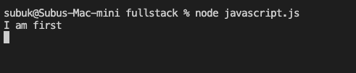
Call Stack
Console
Timer friend
(Node timer thread)
Function Object
100
Event Loop
console.log
String Object
Task Queue

Slide 55
Call Stack
Console
Timer friend
(Node timer thread)
Function Object
0
Event Loop
console.log
Task Queue

Slide 56
Timer friend
(Node timer thread)
Function Object
0
Event Loop
console.log

Slide 57
Call Stack
Console
Timer friend
(Node timer thread)
Event Loop
console.log
Function Object
console.log
String Object
Task Queue

Slide 58
Call Stack
Console
Timer friend
(Node timer thread)
Event Loop
Anonymous function
console.log
Task Queue

Slide 59
Call Stack
Console
Timer friend
(Node timer thread)
console.log
Event Loop
String Object
Anonymous function
console.log
Task Queue

Slide 60
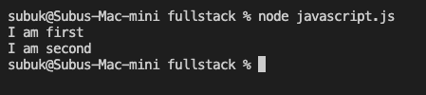
Call Stack
Console
Timer friend
(Node timer thread)
console.log
Event Loop
String Object
Anonymous function
console.log
Task Queue

Slide 61
Call Stack
Console
Timer friend
(Node timer thread)
console.log
Event Loop
console.log
Task Queue

Slide 62
What about the browser?

Slide 63
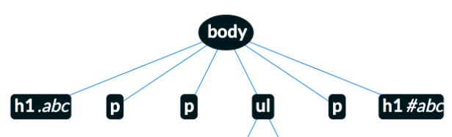

Call Stack
DOM Tree DS
BROWSER
U
I
Renderer friend
(Browser Renderer thread)
Function call detail
User
Event Loop
Task Queue

Slide 64
Call Stack
DOM Tree DS
BROWSER
U
I
Renderer friend
(Browser Renderer thread)
Clicked
Function call detail
User
Event Loop
Task Queue

Slide 65
Call Stack
DOM Tree DS
BROWSER
U
I
Renderer friend
(Browser Renderer thread)
Clicked
Clicked
Function call detail
User
Event Loop
Task Queue

Slide 66
Call Stack
DOM Tree DS
BROWSER
U
I
Renderer friend
(Browser Renderer thread)
Clicked
Clicked
Function call detail
User
Event Loop
Function object for validation
Task Queue

Slide 67
Call Stack
DOM Tree DS
BROWSER
U
I
Renderer friend
(Browser Renderer thread)
Clicked
Clicked
Function Object
User
function object for validation
Event Loop
Task Queue

Slide 68
Who does all This?
libuv is a multi-platform support library with a focus on asynchronous I/O. It was primarily developed for use by Node.js
libev is a high-performance event loop/event model with lots of features used by the Chromium project (needs some verification)

Slide 69
Summary
The infrastructure around JS engines + Hosted environment allows for an effortless asynchronous solution.
The components involve
Call Stack
Event Loop
Task Queue
Microtask Queue (we will discuss this when we see promises)

Slide 70
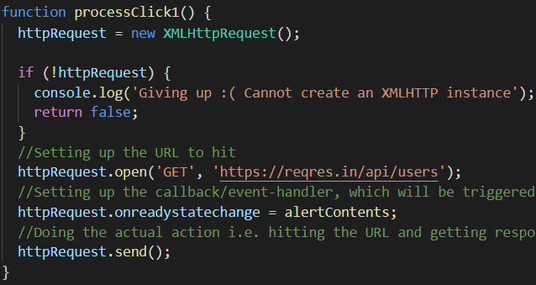
Call Stack
Console
Network friend
(XHC/XHR)
Reqres.in Website
Event Loop
Task Queue

Slide 71
Call Stack
Console
Network friend
(XHC/XHR)
Reqres.in Website
Event Loop
XHR
XMLHHTPRequest.Send()
Task Queue

Slide 72
Call Stack
Console
Network friend
(XHC/XHR)
Reqres.in Website
Object has properties
URL: reqres.in
Callback: alertcontents
Event Loop
XHR
XMLHHTPRequest.Send()
Task Queue

Slide 73
Call Stack
Console
XHR
Network friend
(XHC/XHR)
Reqres.in Website
Event Loop
XMLHHTPRequest.Send()
Task Queue

Slide 74
Call Stack
Console
XHR
Network friend
(XHC/XHR)
Reqres.in Website
Event Loop
Task Queue

Slide 75
Call Stack
Console
XHR
httprequest
Network friend
(XHC/XHR)
Reqres.in Website
Event Loop
Task Queue

Slide 76
Call Stack
Console
XHR
httprequest
Network friend
(XHC/XHR)
Reqres.in Website
httpresponse
Event Loop
Task Queue

Slide 77
Call Stack
Console
httprequest
Network friend
(XHC/XHR)
Reqres.in Website
httpresponse
Event Loop
alertcontents()
Task Queue

Slide 78
Call Stack
Console
httprequest
Network friend
(XHC/XHR)
Reqres.in Website
httpresponse
Event Loop
alertcontents()
Task Queue

Slide 79
Multi-Page vs Single-Page

Slide 80
MULTI PAGE APPLICATION
User
Screen/KeyBoard
Type URL
Browser Software
Server
HTTP request
HTTP Response
PAGE 1
Render Page 1
Click link/ Submit Form
HTTP request
HTTP Response
PAGE 2
Render Page 2

Slide 81
SINGLE PAGE APPLICATION
User
Screen/KeyBoard
Type URL
Browser Software
Server
HTTP request
PAGE
HTTP Response
Render Page
Do any actions
Javascript Engine
Async HTTP request
REST!
Modify portions of the page
HTTP Response

Slide 82
REST - Representational State Transfer
REST is an architectural style for services
Identification & manipulation of resources using HTTP Verbs
For now, you can think of “resources” as
Domain Objects (models) : Customers, Orders, etc
Deeper exploration of webservices in FSD3!
Including History, legacy types & future

Slide 83
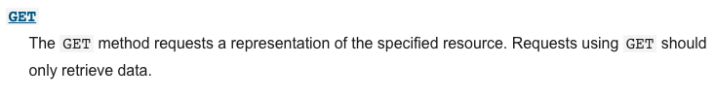
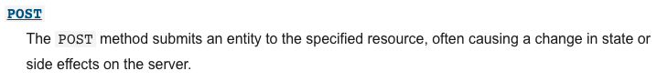
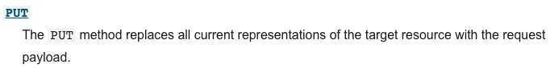
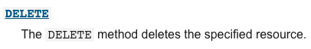
HTTP Verbs
C
R
U
D

Slide 84
SINGLE PAGE APPLICATION - FRONT END DEVELOPMENT PHASE
User
Screen/KeyBoard
Type URL
Browser Software
Server
HTTP request
PAGE
HTTP Response
Render Page
Fake & Simplified Endpoint
Do any actions
Javascript Engine
Async HTTP request
REST!
Modify portions of the page
HTTP Response
So that you can focus primarily on front end development!

Slide 85
LET US UNDERSTAND HTTP
https://developer.mozilla.org/en-US/docs/Web/HTTP

Slide 86
GET SOME REST
https://restfulapi.net/

